Slide 1
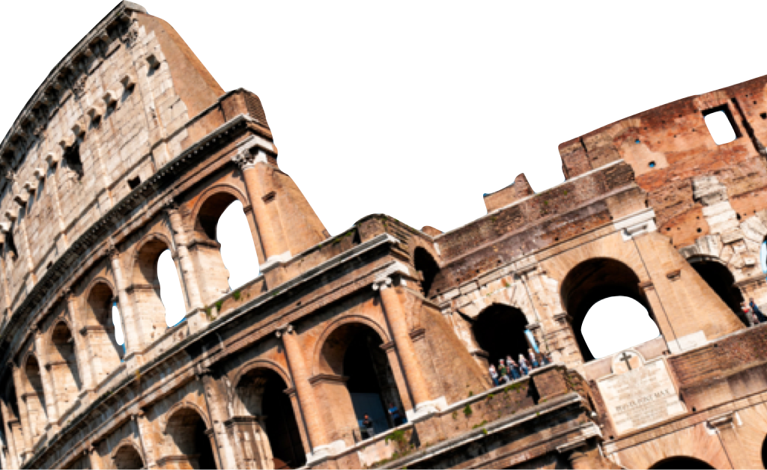
ROMANS
Christ’s Supreme Gift
Romans 5:12-21
Laying a solid foundation
Jesse McLaughlin

Slide 2
Context
Key Verses:
“Therefore, having been justified by faith, we have peace with God through our Lord Jesus Christ” Romans 5:1
“But God demonstrates His own love toward us, in that while we were yet sinners, Christ died for us.” Romans 5:8
“we also exult in God through our Lord Jesus Christ, through whom we have now received the reconciliation.” Romans 5:11
Conclusion: God has always shown us His unique way of love and favor. And He did this while we were still His enemies. Now that we are assured of our salvation and know that He will not give up on us in the future, we are at peace with Him.

Slide 3
The Reign of Death
Romans 5:12-14
¹² Therefore, just as through one man sin entered into the world, and death through sin, and so death spread to all men, because all sinned— ¹³ for until the Law sin was in the world, but sin is not imputed when there is no law.¹⁴ Nevertheless death reigned from Adam until Moses, even over those who had not sinned in the likeness of the offense of Adam, who is a type of Him who was to come. ^{(NASB)}

Slide 4
The Reign of Death
Sin Death Spread to All
“so death spread to all men, because all sinned” Romans 5:12
Paul uses the idea of _____________________________ in chapter 5 for both Adam & Jesus Christ.
“There can be but one explanation. All died because all sinned in and through Adam, the representative or federal head of the human race” – John Stott
Representative Headship

Slide 5
The Reign of Death
Once God gives the Law to Israel sin can now be ______________ (or attributed) to the offender because the way of righteousness has been made clear.
Adam is a type of Christ (v. 14).
Imputed

Slide 6
The Transgression & The Gift
Romans 5:15-17
¹⁵ But the free gift is not like the transgression. For if by the transgression of the one the many died, much more did the grace of God and the gift by the grace of the one Man, Jesus Christ, abound to the many. ¹⁶ The gift is not like that which came through the one who sinned; for on the one hand the judgment arose from one transgression resulting in condemnation, but on the other hand the free gift arose from many transgressions resulting in justification. ¹⁷ For if by the transgression of the one, death reigned through the one, much more those who receive the abundance of grace and of the gift of righteousness will reign in life through the One, Jesus Christ. (NASB)

Slide 7
The Transgression & The Gift
Adam’s sin is identified as “the transgression”. Adam gives his children death through his transgression.
“Gift” and “grace” are repeated because Jesus offers all who bear His name the undeserved, free gift of eternal life.

Slide 8
The Transgression & The Gift
Romans 5:15-17
¹⁵ But the free gift is not like the transgression. For if by the transgression of the one the many died, much more did the grace of God and the gift by the grace of the one Man, Jesus Christ, abound to the many. ¹⁶ The gift is not like that which came through the one who sinned; for on the one hand the judgment arose from one transgression resulting in condemnation, but on the other hand the free gift arose from many transgressions resulting in justification. ¹⁷ For if by the transgression of the one, death reigned through the one, much more those who receive the abundance of grace and of the gift of righteousness will reign in life through the One, Jesus Christ. (NASB)

Slide 9
The Transgression & The Gift
Adam’s sin is identified as “the transgression”. Adam gives his children death through his transgression.
“Gift” and “grace” are repeated because Jesus offers all who bear His name the undeserved, free gift of eternal life.
“That one single misdeed should be answered by judgment, this is perfectly understandable: that the accumulated sins and guilt of all the ages should be answered by God’s free gift, this is the miracle of miracles, utterly beyond human comprehension.”
– Charles Cranfield

Slide 10
Contrasting Disobedience & Obedience
Romans 5:18-21
¹⁸ So then as through one transgression there resulted condemnation to all men, even so through one act of righteousness there resulted justification of life to all men.¹⁹ For as through the one man’s disobedience the many were made sinners, even so through the obedience of the One the many will be made righteous. 20 The Law came in so that the transgression would increase; but where sin increased, grace abounded all the more, ²¹ so that, as sin reigned in death, even so grace would reign through righteousness to eternal life through Jesus Christ our Lord. (NASB)

Slide 11
Contrasting Disobedience & Obedience
Disobedience of Adam leads to condemnation (death & judgment). The obedience of Christ grants the free gift of righteousness to all who believe.
The Law increases transgression by making the righteous standard of God evident.
Some argue that Paul is presenting evidence for _______________in Romans 5 because he refers to “all men” & “many” regarding both death through Adam and life through Christ.
universalism

Slide 12
Contrasting Disobedience & Obedience
“Universalism involves the affirmation of universal salvation and the denial of eternal punishment. Universalists believe that ultimately all humans are somehow in union with Christ and that in the fullness of time they will gain release from the penalty of sin and be restored to God”
Pocket dictionary of theological terms (p. 118). InterVarsity Press.

Slide 13
Contrasting Disobedience & Obedience
Context – Paul repeats the concept that men & women are only “justified by faith” (Romans 5:1)
Headship – All people are under Adam’s headship by nature of being born human. However, to be under Christ as your head you must experience new birth through faith. This is seen in Romans 5:17 reads, “those who receive the abundance of grace” not everyone receives this grace.
Ethnic Unity - “All” can also serve as a unifier meaning that all people no matter heritage (Jew or Gentile) have received death through Adam and may receive life through Jesus Christ.

Slide 14
Conclusion
Those who have been “justified by faith” (5:1) escape the consequences of Adam’s sin through the gracious gift of Christ. He has secured eternal life through his righteousness and obedience which are imputed to Christians as a free gift.

Slide 15
Discussion Questions
Do you believe that everyone is born a sinner? Is it fair that God judges us for a sin committed by Adam?
What does Christ accomplish for those who believe?
Have you struggled with the idea of universalism?

